Slide 1

What’s new with IBM MQ: Messaging for the Modern Era August 2020 – includes MQ 9.2
Mark Taylor
MQ Development
IBM Hursley
Notes:
Author – David Ware

Slide 2
28143: What's New in IBM Messaging August 2020 – includes IBM MQ 9.2
Mark Taylor
marke_taylor@uk.ibm.com
IBM Hursley

Slide 3
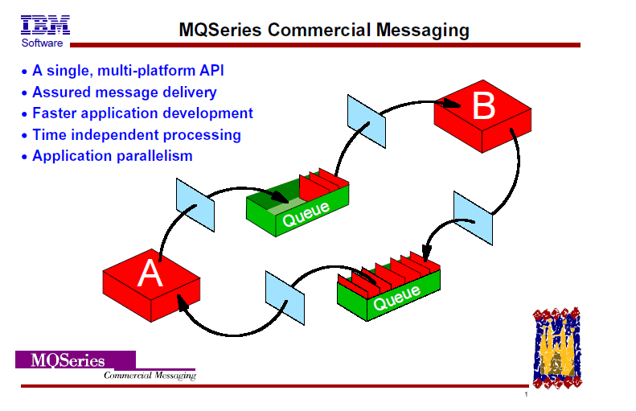
What is MQ – the 1995 version

Slide 4
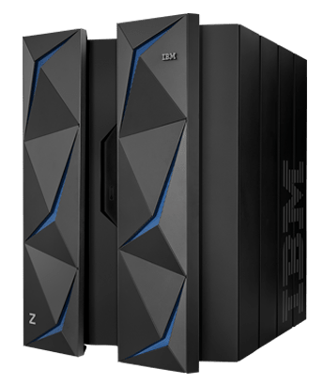



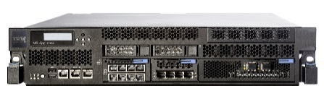

Run IBM MQ in any location or cloud, exactly as you need it
On-premise, software and the MQ Appliance
Run MQ yourself in public or private clouds
Let IBM host MQ for you with its managed SaaS MQ service in public clouds, IBM Cloud and AWS
AWS
Azure
IBM Z
Linux
AIX
AWS
Windows
IBMi
HPE NonStop
zLinux
Appliance
Kubernetes

Slide 5






IBM MQ Transformation
Developer Agility
Delivery teams are being empowered within the organization. They need to be enabled to complete their day to day operations independently.
Adopt Multi-Cloud
Delivery teams are empowered to select their cloud of choice, and expect connectivity to be provided across these.
Operational Agility
IBM MQ operational teams are being challenged to simplify the management of their infrastructure to drive cost savings.
Organic Growth
Organizations that originally chosen IBM MQ for a project that has matured, and need improved scalability, availability and security.

Slide 6
IBM MQ: long term support and continuous delivery
2014
2015
2016
2017
2018
2019
2020
V8.0
V9.0 LTS
V9.0.1 CD
V9.0.2 CD
V9.0.3 CD
V9.0.4 CD
V9.0.5 CD
V9.1 LTS
V9.1.1 CD
V9.1.2 CD
V9.1.3 CD
V9.1.4 CD
V9.1.5 CD
V9.2 LTS
…
available
available
IBM MQ Appliance M2000
IBM MQ Appliance M2001
MQ on IBM Cloud
Future
In 2016 MQ introduced a dual Long Term Support and a Continuous Delivery model.
Continuous Delivery
New CD versions of MQ are released approximately every four months, incrementally introducing new product capabilities.
Intended for those that can continually integrate.
Long Term Support
Approximately every two years a new LTS version is released, rolling up many of the CD capabilities into a release with 5+3 support attached.
Required by those looking for fixed function.
Mix and Match
Both are available under the same license.
Both can interoperate, just like any previous version of MQ.
All the function delivered in the 9.1.x CD releases will be available in the long term support release V9.2 LTS

Slide 7
MQ 9.0.x CD content, included with V9.1 LTS
Replicated Data Queue Manager for MQ Advanced
Linear logging automation and performance
RESTful administration
Error log formatting
Web Console
RESTful messaging
MQ Appliance performance improvements
MQ JMS in CICS Liberty Profile
Salesforce bridge
AMS confidentiality performance on z/OS Advanced
Blockchain bridge for MQ Advanced
Floating IP support for MQ Appliance
Code repository integration
Backup and Restore on MQ Appliance
Redistributable MFT agent for MQ Advanced
Enhanced MFT diagnostics
Cross LPAR MFT agents for z/OS Advanced
SNMP and REST support for MQ Appliance
Notes:
All the MQ 9.0.x CD content will become available with the next LTS release.
We don’t have time to look at all these features in turn, we’ll focus on a few…

Slide 8
MQ 9.2 LTS content…
Uniform Cluster automatic application rebalancing
Microsoft .NET Core support
Client connectivity with zCEE
Developer toolkit for MacOS
Automatic TLS CipherSpec negotiation
Enhanced Salesforce Bridge
Build toolkit for zCEE
Idempotent MQSC commands
Browse messages using REST
MQ Appliance certificate expiry notifications
Channel enabled AMS policies for z/OS
JSON format CCDT
Permitted TLS CipherSpec control
REST messaging performance enhancements
Full JSON-syntax REST administration
MQ Appliance HA event notifications
Improved distributed queue manager restart times
Stream MQ Appliance error logs
Rapid Uniform Cluster rebalancing
Improved MQIPT management
New application status checking
ini file and MQSC injection at startup
Escalating end queue manager
MQFT REST list resource monitors
Enhanced Blockchain Bridge
WebSphere Liberty MDB pause
New consistent MQ samples
MFT REST create file transfer
FTP server support on IBM I for MFT
AMS HSM with Oracle JRE
MQ Appliance admin activity audit logging
XA support in Liberty for decoupled JMS connections
Automatic Uniform Cluster configuration
Packaged MQ Internet Passthru (IPT)
Highly available MFT Agent deployments
z/OS data set encryption support
User controlled application naming
TLS 1.3 support …
High speed transfer over long distances with Fasp.io
Qpid JMS shared subscriptions
Publish messages over REST
.NET project templates
Increased queue size support for Distributed
New improved Web Console
Full HA-DR-HA replicated data queue manager deployments
Uniform Cluster application monitoring
Java 11 application support
Distributed queue size control

Slide 9
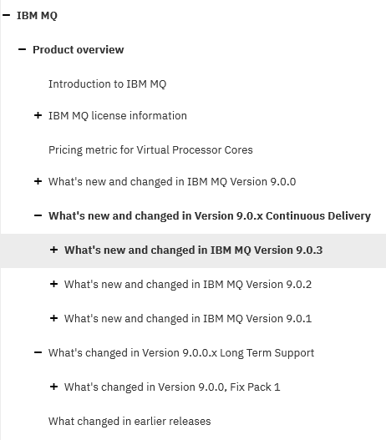
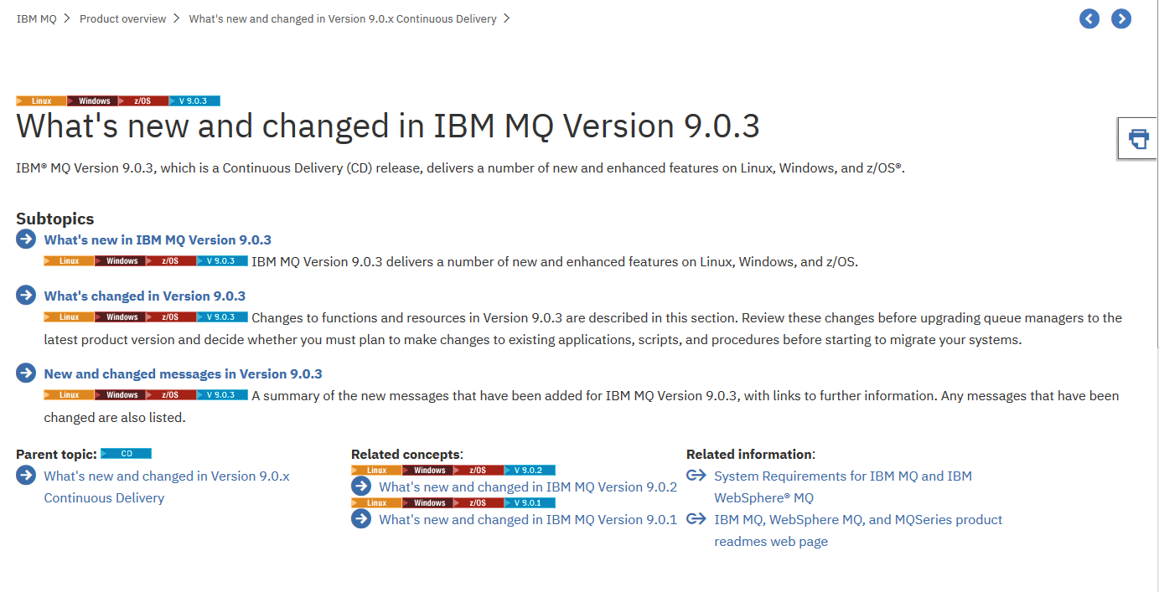
MQ release-to-release changes
Always read the What’s new and changed sections of the Knowledge Centre to see what each release adds

Slide 10




MQ in Containers, continually evolving
MQ first supported Docker containers in 2015, showing how a stateful solution can run in an often stateless world.
MQ was one of the first certified containers available on IBM’s Kubernetes platform, IBM Cloud Private. Showing how to run MQ in a managed container environment.
MQ added support for running on Red Hat OpenShift
MQ is a core component of IBM’s Cloud Pak for Integration, providing enterprise messaging for the Integration Platform solution
hub.docker.com/r/ibmcom/mq github.com/ibm-messaging/mq-container
2015
2020

Slide 11

MQ Operator
Operators codify operational knowledge and workflows to automate life-cycle management of containerized applications with Kubernetes
apiVersion: mq.ibm.com/v1beta1 kind: QueueManager metadata: name: quickstart-cp4i spec: version: 9.1.5.0-r2 license: accept: false license: L-RJON-BN7PN3 use: NonProduction web: enabled: true queueManager: name: "QUICKSTART" storage: queueManager: type: ephemeral ….

Slide 12




MQ on Cloud service
Managed for You
Configured &
monitored
by the customer
Queues, topics, channels, clustering, applications
Up and Running in Minutes
MQ installation, basic configuration, security, maintenance
Hourly billing
Managed &
operated
by IBM
Hardware, virtualization, servers, network, storage
Enabled for Hybrid Cloud Connectivity
Try the service for free www.ibm.com/cloud/mq

Slide 13



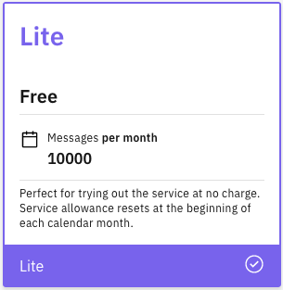
The evolution on the MQ on Cloud service
Continually broadened coverage to multiple geographical regions and across multiple public clouds – IBM Cloud and AWS
Added the ability to use indefinitely with no financial commitment through the Lite Plan
Simplified administration with SSO and improvements for diagnostics
Continually enhancing operational efficiencies which goes on to guide MQ’s evolution

Slide 14
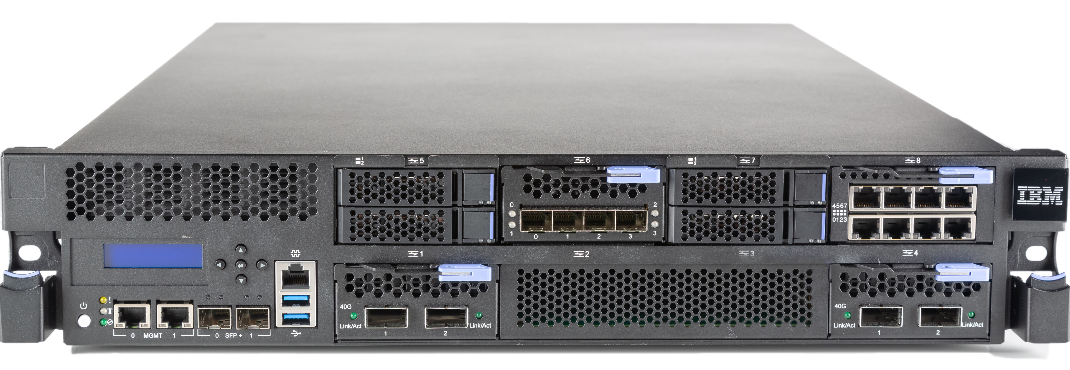
Easy Integration
Integrates seamlessly into MQ networks and and clusters
Improved Availability
Built-in support for High Availability and Disaster Recovery
MQ Appliance
The scalability and security of IBM MQ
The same familiar administration model for administrators with MQ skills
Supports the same MQ applications
But, with the convenience, fast time-to-value and low total cost of ownership of an appliance
Simplified ownership
Repeatable and fast, with less configuration or tuning required
Minimises dependencies on other resources and teams
Simpler licensing and easier to assess for security compliance and audit

Slide 15

Since 9.1
The MQ Appliance has been maturing, taking in real life experiences to drive improvements for all users
Improved diagnostics and setup
Streaming error logs
Network config tooling
Recoverable error reports
Improved HA and DR
Added resiliency to failures
Status notifications for monitoring

Slide 16
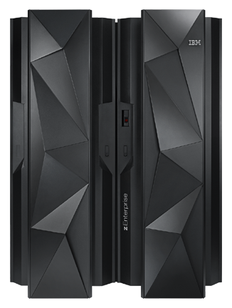
Resilience
Queue sharing groups exploit the z/OS Parallel Sysplex for unparalleled high availability
Performance
Create high performance environments able to process millions of messages every second
MQ for z/OS
Maximum resilience, performance, and secure connectivity
zHyperWrite Improves the I/O performance of synchronous replication solutions for disaster recovery
CICS
Direct connectivity with IBM Event Streams
Kafka connectors for MQ can be deployed into z/OS UNIX System Services, reducing latency and simplifying configuration
IMS
Secure connectivity
Adapters and bridges provide tight integration with your business critical Systems of Record
Consistent connectivity with a range of other on-premise and cloud platforms
MQ exploits System SSL on z/OS to utilize CPACF and CryptoExpress cards for pervasive encryption
WAS
Advanced Message Security
Users are able to apply and remove Advanced Message Security (AMS) policies transparently between AMS and non-AMS enabled queue managers
DB2
Batch
Full data encryption
MQ 9.1.5 completed support for full DataSet encryption, integrating with the CryptoExpress coprocessor for encryption at the storage level

Slide 17
Linux High Availability
Protecting your critical data

Slide 18


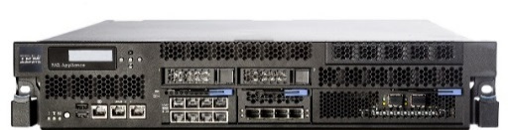
Fault Tolerance
Sysplex Coupling Facility
MQ delivers HA through the ability to build horizontally scaled, active-active systems and typically active-passive HA of the data itself*, the messages.
Traditionally active-passive HA has been achieved through HA clusters or multi instance queue managers. Both rely on highly available infrastructure to be setup and relied on.
The MQ Appliance changed this with a fully integrated HA solution, providing built in machine to machine data replication and failover.
And even more recently, Replicated Data Queue Managers on RHEL x86 have provided even more options.
shared storage
z/OS Queue Sharing Groups
Multi-instance queue managers and HA Cluster
MQ Appliance
local storage
local storage
local storage
* z/OS shared queue provides active-active HA of the message data!
Replicated Data Queue Manager

Slide 19
Combining HA with DR
IBM MQ Advanced 9.1.5 CD RHEL x86
IBM MQ 9.1.5 CD combines two existing RDQM topologies into one
Previously it was a choice between either automatic HA failover with a three node HA group or a manual two node failover configuration supporting asynchronous replication for higher latency deployments (e.g. DR). Not both together.
You can now build a three node HA quorum system, asynchronously replicating queue manager state to a matching three node HA quorum system for simpler DR switch over setups
Both HA quorum systems can be running different active queue managers, with bidirectional asynchronous replication, supporting active/active DR topologies
A three node quorum for synchronous replication and automatic failover of multiple queue managers
Node 1
Node 2
Node 3
active
sync
sync
synchronous replication
async
async
async
asynchronous replication
asynchronous replication
Node 4
Node 5
Node 6
async
async
async
sync
sync
active
synchronous replication

Slide 20
High Availability with Kubernetes
The RDQM solution does not apply to container environments
High availability of the MQ data requires highly available replicated storage
Container orchestrators such as Kubernetes handle much of the monitoring and restart responsibilities…
Kubernetes
Node 1
Node 2
Node 3
StatefulSet, Replicas=1
Pod 1
HA network storage

Slide 21

High Availability with Kubernetes
The RDQM solution does not apply to container environments
High availability of the MQ data requires highly available replicated storage
Container orchestrators such as Kubernetes handle much of the monitoring and restart responsibilities…
…but not all. StatefullSets such as MQ are not automatically restarted following a Kubernetes node failure
Kubernetes
Node 2
Node 3
StatefulSet, Replicas=1
HA network storage

Slide 22
High Availability with Kubernetes
IBM MQ 9.1.3 CD
The RDQM solution does not apply to container environments
High availability of the MQ data requires highly available replicated storage
Container orchestrators such as Kubernetes handle much of the monitoring and restart responsibilities…
…but not all. StatefullSets such as MQ are not automatically restarted following a Kubernetes node failure
The MQ container image and Certified Container supports a two-replica multi-instance queue manager deployment pattern to handle Kubernetes node failures
Kubernetes
Node 1
Node 2
Node 3
StatefulSet, Replicas=2
Pod 1
Pod 2
multi-instance active
multi-instance standby
HA network storage
https://www.ibm.com/support/knowledgecenter/SSFKSJ_9.1.0/com.ibm.mq.ctr.doc/ha_for_ctr.htm

Slide 23
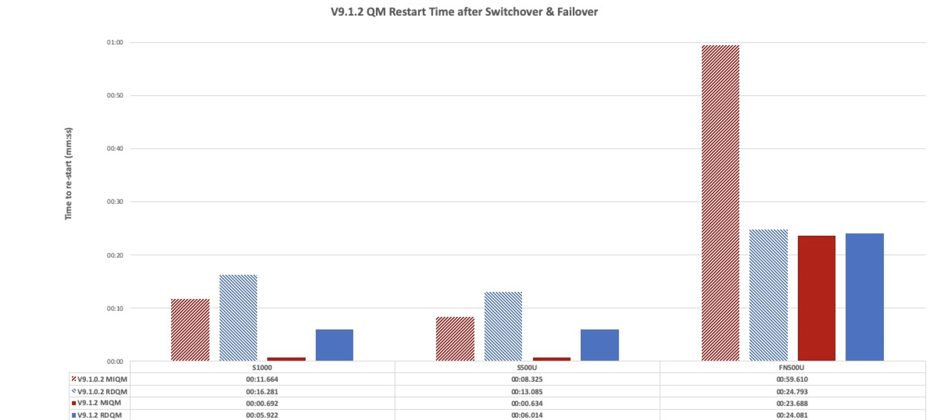





Increasing your availability further
IBM MQ 9.1.1+ CD
With automatic queue manager failover, queue manager restart times have an increasing part to play in achieving the highest levels of availability
MQ 9.1.x CD has focused on driving down the time it takes to stop and start distributed queue managers under load
Operator instigated switch over Abrupt failover
V9.1.0.2 Multi-instance queue manager
V9.1.0.2 Replicated data queue manager
V9.1.2 Multi-instance queue manager
V9.1.2 Replicated data queue manager
ibm-messaging.github.io/mqperf/Queue%20Manager%20Restart%20Times.pdf
500 connected applications, driving 50k-85k msgs/sec

Slide 24
Active/active messaging
Building scalable, fault tolerant, solutions

Slide 25
Building scalable, fault tolerant, solutions
App
App
App
To provide an active/active, solution you need to consider multiple active queue managers acting as a single service
Applications also run as multiple instances for availability and scale
Applications treat the queue managers as interchangeable and want to connect to the group in the most efficient and available distribution
MQ introduced the Uniform Cluster capability in 9.1.2 CD to enable such deployments much more easily
decoupled

Slide 26
Building scalable, fault tolerant, solutions
App
App
App
Uniform Clusters are a special type of MQ Cluster. One where all the queue managers provide the same service, such as queues.
Application instances are dynamically distributed across the available queue managers, adjusting as queue managers and application instances stop and start.
A uniform cluster builds on top of existing MQ building blocks -
Client auto-reconnect CCDT queue manager groups MQ Clustering
Application awareness
Uniform Cluster

Slide 27

Automatic Application balancing
App
App
App
App
App
App
Uniform Clusters are a special type of MQ Cluster. One where all the queue managers provide the same service, such as queues.
Application instances are dynamically distributed across the available queue managers, adjusting as queue managers and application instances stop and start.
A uniform cluster builds on top of existing MQ building blocks -
Client auto-reconnect CCDT queue manager groups MQ Clustering

Slide 28
Automatic Application balancing
App
App
App
App
App
App
Uniform Clusters are a special type of MQ Cluster. One where all the queue managers provide the same service, such as queues.
Application instances are dynamically distributed across the available queue managers, adjusting as queue managers and application instances stop and start.
A uniform cluster builds on top of existing MQ building blocks -
Client auto-reconnect CCDT queue manager groups MQ Clustering

Slide 29
View application status
DISPLAY APSTATUS(*) TYPE(APPL)
AMQ8932I: Display application status details.
APPLNAME(AMQSPHAC) CLUSTER(UNIDEMO)
COUNT(8) MOVCOUNT(8)
BALANCED(YES)
AMQ8932I: Display application status details.
APPLNAME(AMQSPUTC) CLUSTER( )
COUNT(2) MOVCOUNT(0)
BALANCED(NOTAPPLIC)
DISPLAY APSTATUS(*) TYPE(QMGR)
AMQ8932I: Display application status details.
APPLNAME(AMQSPHAC) ACTIVE(YES)
COUNT(3) MOVCOUNT(3)
BALSTATE(OK) LMSGDATE(2019-05-08)
LMSGTIME(14:05:36) QMNAME(UNID001)
QMID(UNID001_2019-05-08_13.59.31)
AMQ8932I: Display application status details.
APPLNAME(AMQSPHAC) ACTIVE(YES)
COUNT(3) MOVCOUNT(3)
BALSTATE(OK) LMSGDATE(2019-05-08)
LMSGTIME(14:04:50) QMNAME(UNID002)
QMID(UNID002_2019-05-08_13.59.35)
AMQ8932I: Display application status details.
APPLNAME(AMQSPHAC) ACTIVE(YES)
COUNT(2) MOVCOUNT(2)
BALSTATE(OK) LMSGDATE(2019-05-08)
LMSGTIME(14:04:44) QMNAME(UNID003)
QMID(UNID003_2019-05-08_13.59.40)
AMQ8932I: Display application status details.
APPLNAME(AMQSPUTC) ACTIVE(YES)
COUNT(2) MOVCOUNT(0)
BALSTATE(NOTAPPLIC) LMSGDATE(2019-05-08)
LMSGTIME(14:05:36) QMNAME(UNID001)
QMID(UNID001_2019-05-08_13.59.31)
Now that MQ is taking a more application centric view, a new command has been added to Distributed runmqsc to aid the understanding of how applications are balanced across a Uniform Cluster
From any member of the Uniform Cluster, displays applications by name and highlights instances that are not evenly balanced
MQ 9.1.5 CD adds to this by regularly publishing metrics to the system topics on how each application is being rebalanced, enabling live monitoring
community.ibm.com/community/user/imwuc/viewdocument/ display-application-status-on-a-uni
community.ibm.com/community/user/imwuc/blogs/louis-horsley1/ 2020/04/06/uniform-cluster-monitor-application-resource-usage

Slide 30
Extend your MQ network

Slide 31
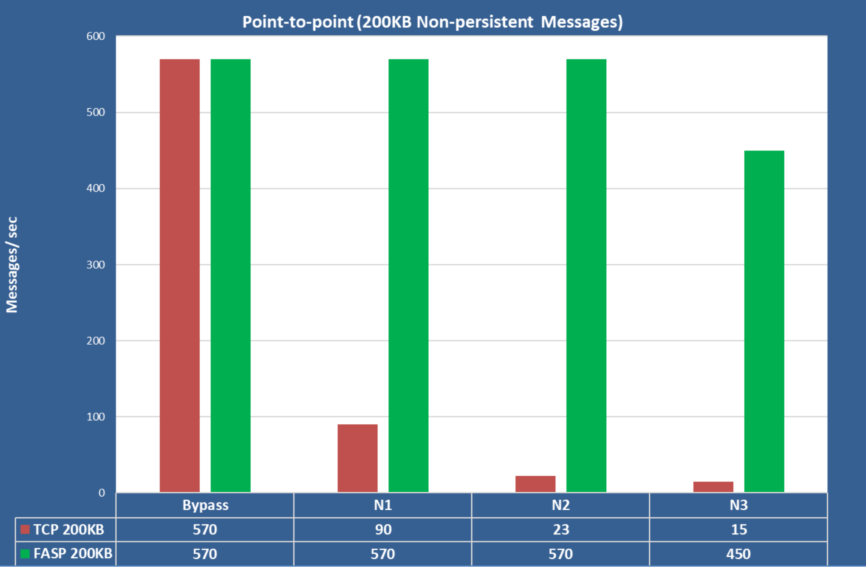
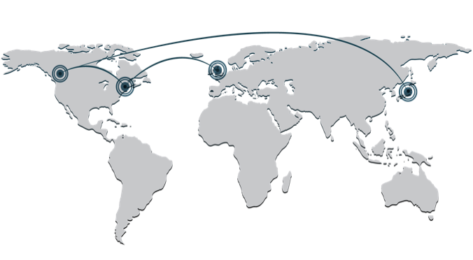
A Global Messaging Network IBM MQ Advanced and Aspera
At the heart of Aspera is the FASP protocol, accelerating the speed of data transport across long distances and poor networks
MQ Advanced brings you the benefits of this when communicating between distant queue managers
Bypass: 0ms network latency (no packet loss)
N1: 25ms network latency (no packet loss)
N2: 40ms network latency (0.1% packet loss)
N3: 50ms network latency (0.5% packet loss)
TCP/IP
Gateway
FASP.io
Gateway
TCP/IP
Queue Manager
Queue Manager
ibm-messaging.github.io/mqperf/MQ914_fasp_gw.pdf

Slide 32
A Global Messaging Network Internet Pass Through
With a Hybrid Multi-Cloud Architecture connecting to external MQ networks is becoming increasingly important.
Internet Pass Through (IPT) has been an IBM MQ support Pac (MS81) for many years. It provides a proxy layer within your architecture which can be useful when exposing MQ outside of the organization data center.
MQ 9.1.4 aligned IPT with the MQ product delivery
MQ Advanced now provides an enhanced IPT entitlement where a Hardware Security Module (HSM) can be used with IPT.
Guidance on how to expose MQ is also provided here:
ibm.biz/MQSecureConn
IBM Cloud
Google Cloud
App
App
TCP/IP
App
App
App
IBM MQ
IBM MQ
App
TCP/IP
Multi-Cloud Cluster
TCP/IP
IBM MQ
App
App
App
App
App
App
On Premise
Ownership
Messaging Layer
Application
Client Bindings
Server Bindings
Container(s)

Slide 33












IBM MQ with IBM Event Streams
IBM MQ connects mission-critical systems, requiring transactional, once-only delivery
Event Streams distributes and processes streams of events in real-time to intelligently engage with customers
Connecting the two together, flowing messages and events between then, with the supported connectors enables you to unlock the potential of your data

Slide 34
Managing MQ
Living with your enterprise messaging system

Slide 35

Automation with MQ
IBM MQ 9.1.4 CD
Scripting is key to automation. MQ has supported scripting through MQSC scripts.
MQ has been evolving to make this even easier
Remote runmqsc enables scripts to be deployed from a system remote to the queue manager
MQSC commands are now more idempotent
Queue managers can now automatically pull in updated MQSC scripts and ini file settings at start time (MQ 9.1.4)
New REST API support opens up administration over HTTP using JSON (MQ 9.1.3)
AutoCluster:
Type=Uniform
ClusterName=UNIDEMO
DEFINE CHANNEL(….. DEFINE QLOCAL(…. ….
deploy

Slide 36
REST administration
IBM MQ 9.1.3 CD All Platforms
JSON format, MQSC style, REST commands
Send request body in HTTP POST to admin/action/qmgr/{qmgrName}/mqsc resource
New command type of “runCommandJson”
Existing command type of “runCommand” can still be used to run a plain text MQSC command
DEFINE QLOCAL(Q1) DESCR(‘My queue’)
Primary command keyword
Optional
additional
parameters
Secondary command
keyword
Primary argument (often an object name)
JSON equivalent
{
"type": "runCommandJSON",
"command": "define",
"qualifier": "qlocal",
"name": "q1",
"parameters": {
"descr": "My queue"
}
}
MQ 9.1.5 CD carries these APIs over into a new V2 of the REST API. Earlier APIs for per-object manipulation have been stabilised at V1
www.ibm.com/support/knowledgecenter/en/SSFKSJ_9.1.0/com.ibm.mq.pro.doc/q133690_.htm#q133690___restapiv2

Slide 37




Code as Config for the applications too
IBM MQ 9.1.2+ CD Clients
Applications should never encode the MQ connection details, not even the queue manager
MQ CCDTs encapsulate the connection details
You can now build your own JSON format CCDTs
These can be deployed as part of the same pipeline that deploys your queue managers and applications
Supports multiple channels of the same name on different queue managers to simplify the building of uniform clusters
QMA
QMB
App
CCDT
{
“channel”:[ {
“name”:”ABC”, ”queueManager”:”QMA”
},
{
“name”:”ABC”, ”queueManager”:”QMB”
},
]
}

Slide 38
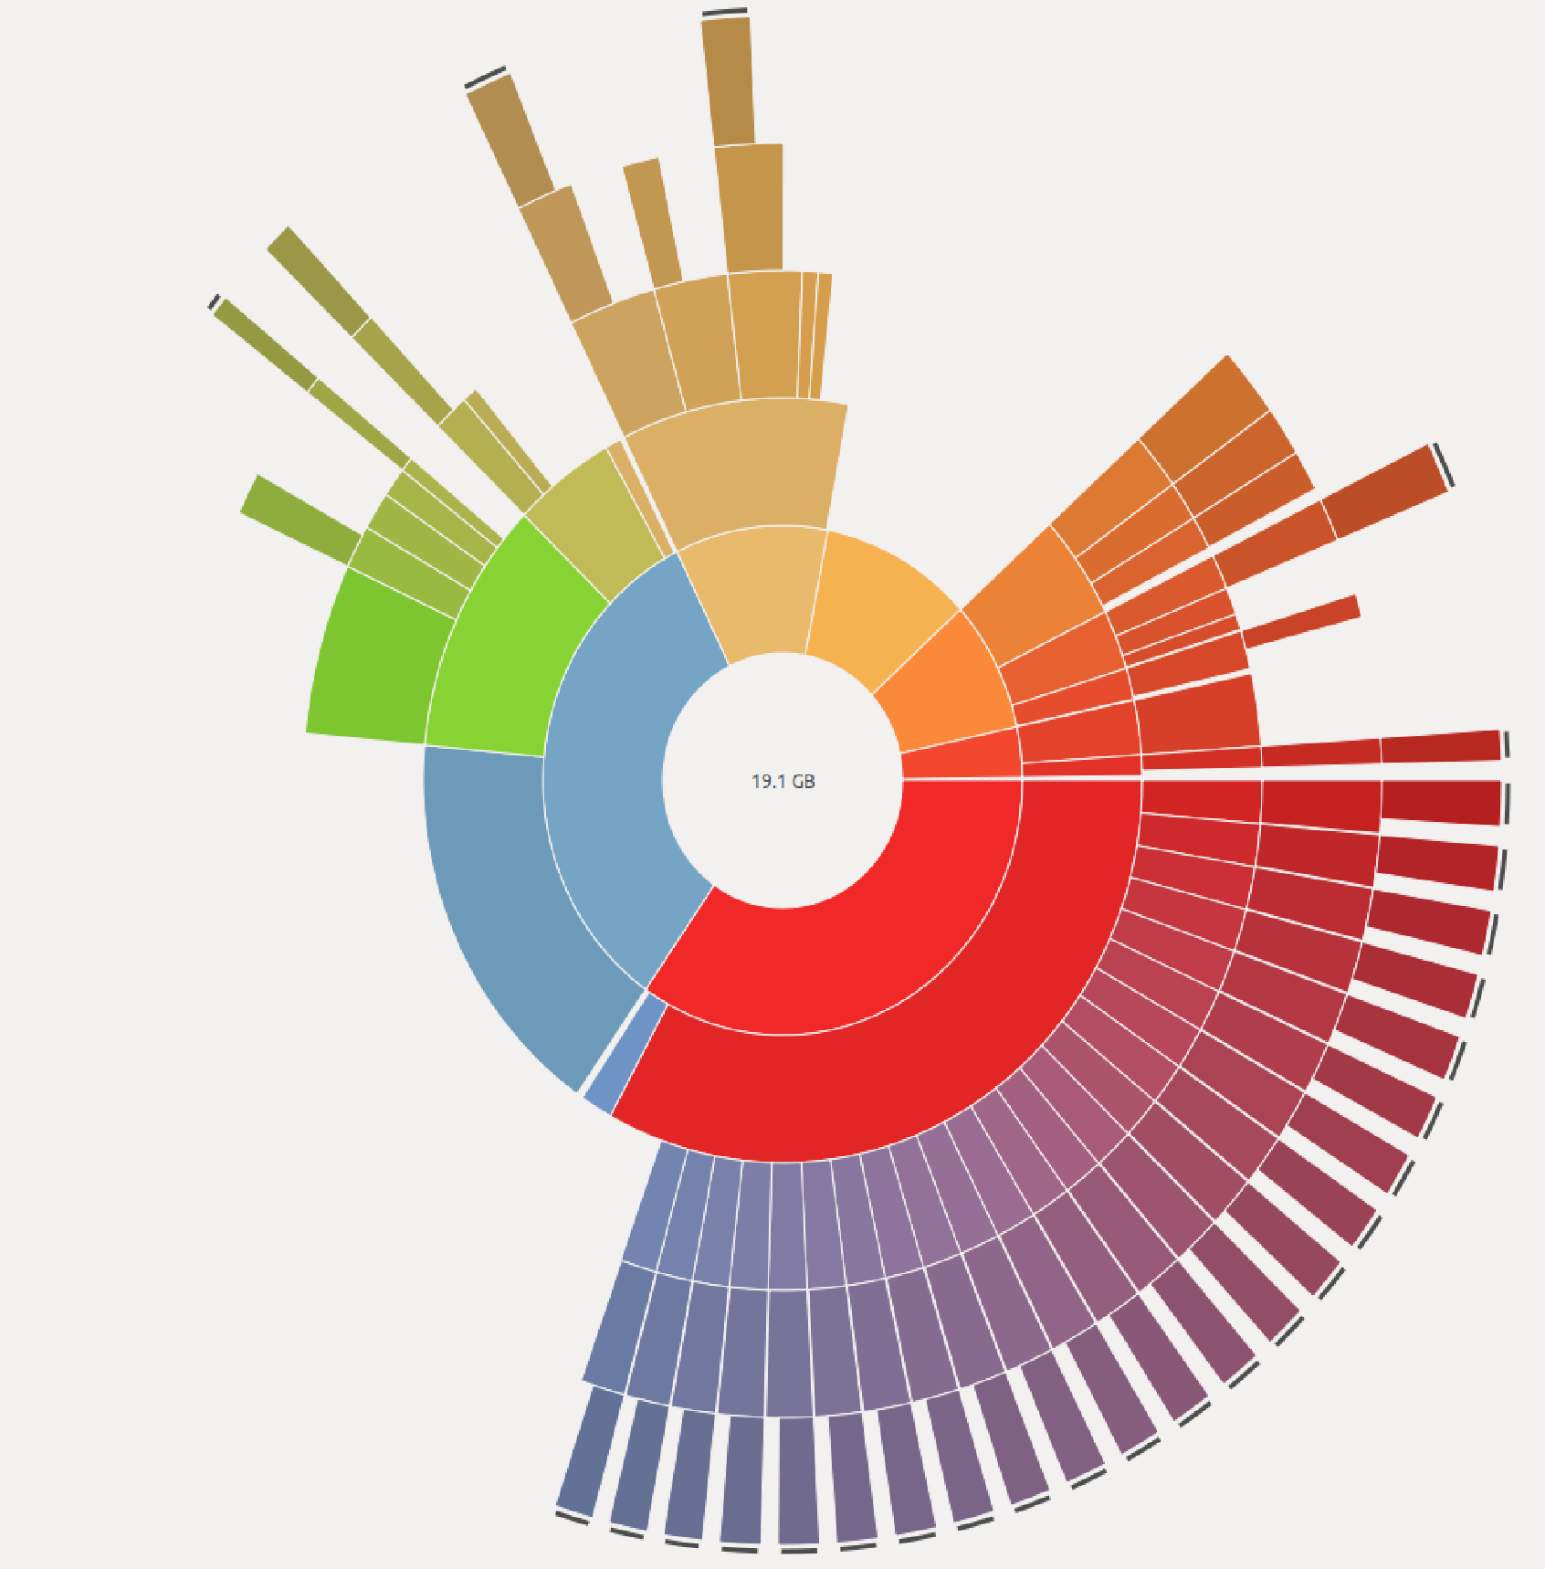

Queue size control
IBM MQ 9.1.5 CD Distributed
Distributed platforms and the Appliance have introduced per-queue disk space control with MQ 9.1.5 CD.
This enables much greater control over resource usage by individual applications.
Queue size control has also introduced the ability for queues to be much larger than the previously fixed 2 terabytes. This improves MQ’s ability to temporarily buffer significant messaging traffic during an extended outage.
The maximum supported size is now 255TB
community.ibm.com/community/user/imwuc/blogs/louis-horsley1 /2020/04/08/easily-controllable-queue-file-sizes

Slide 39
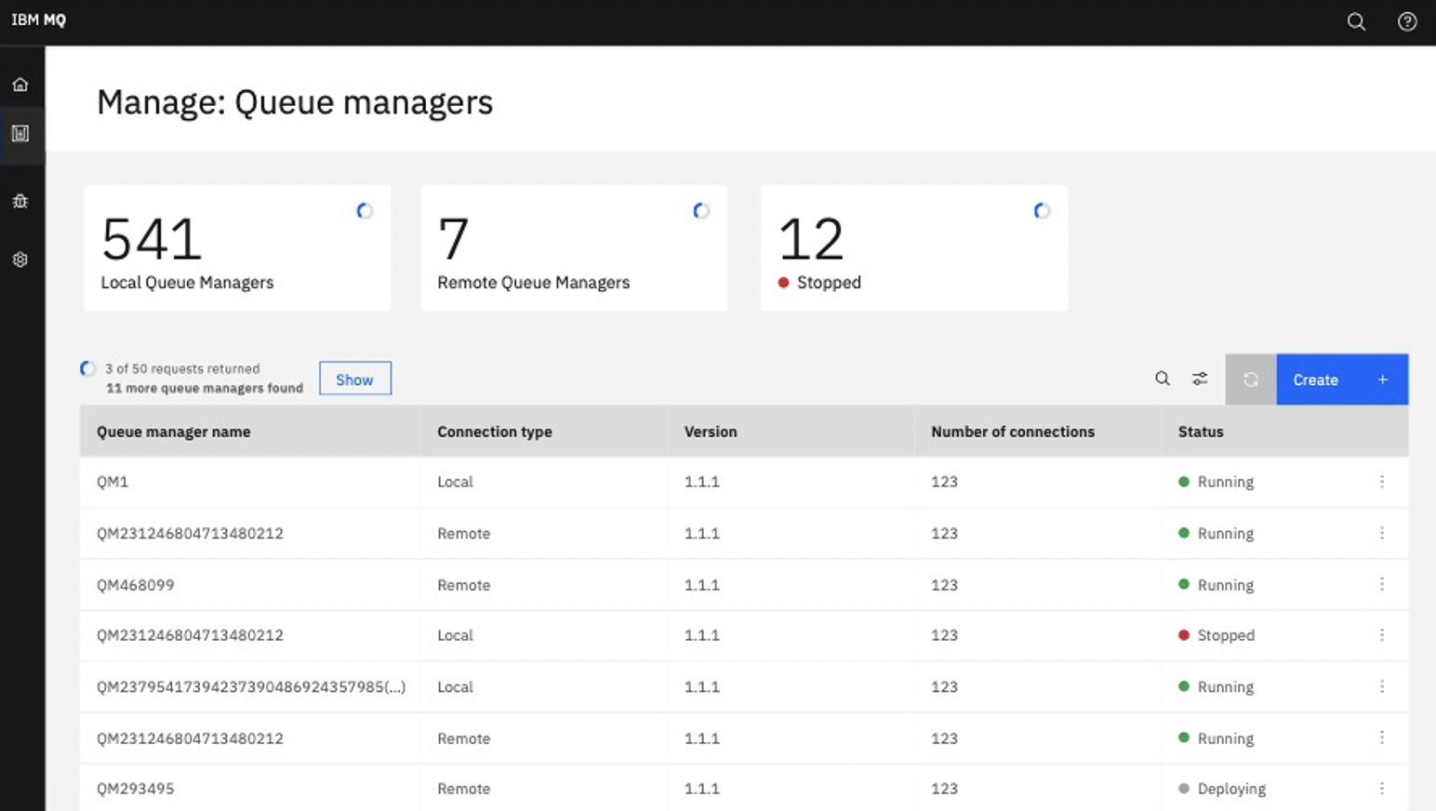
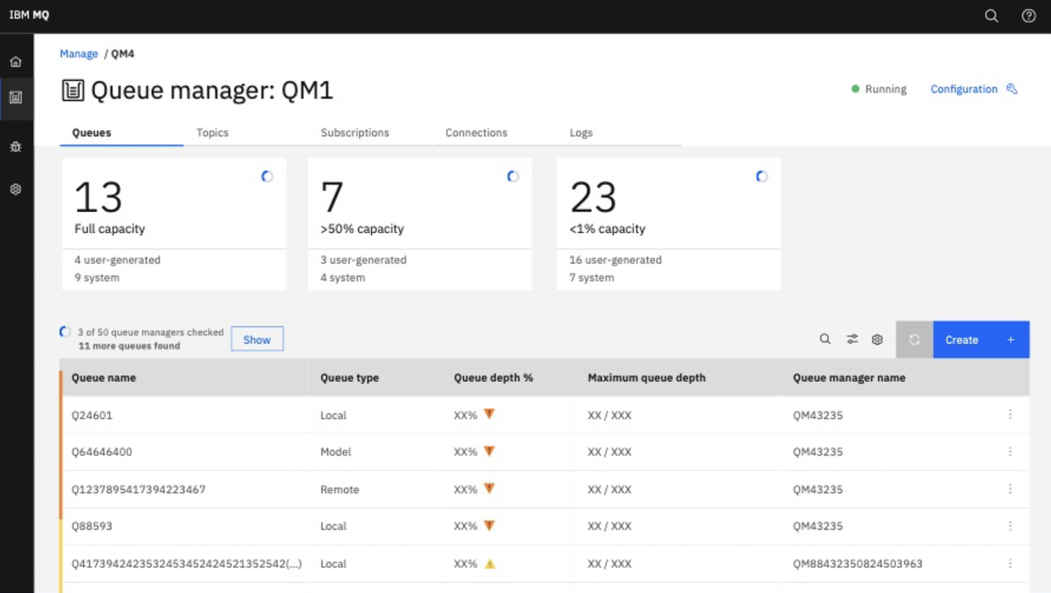
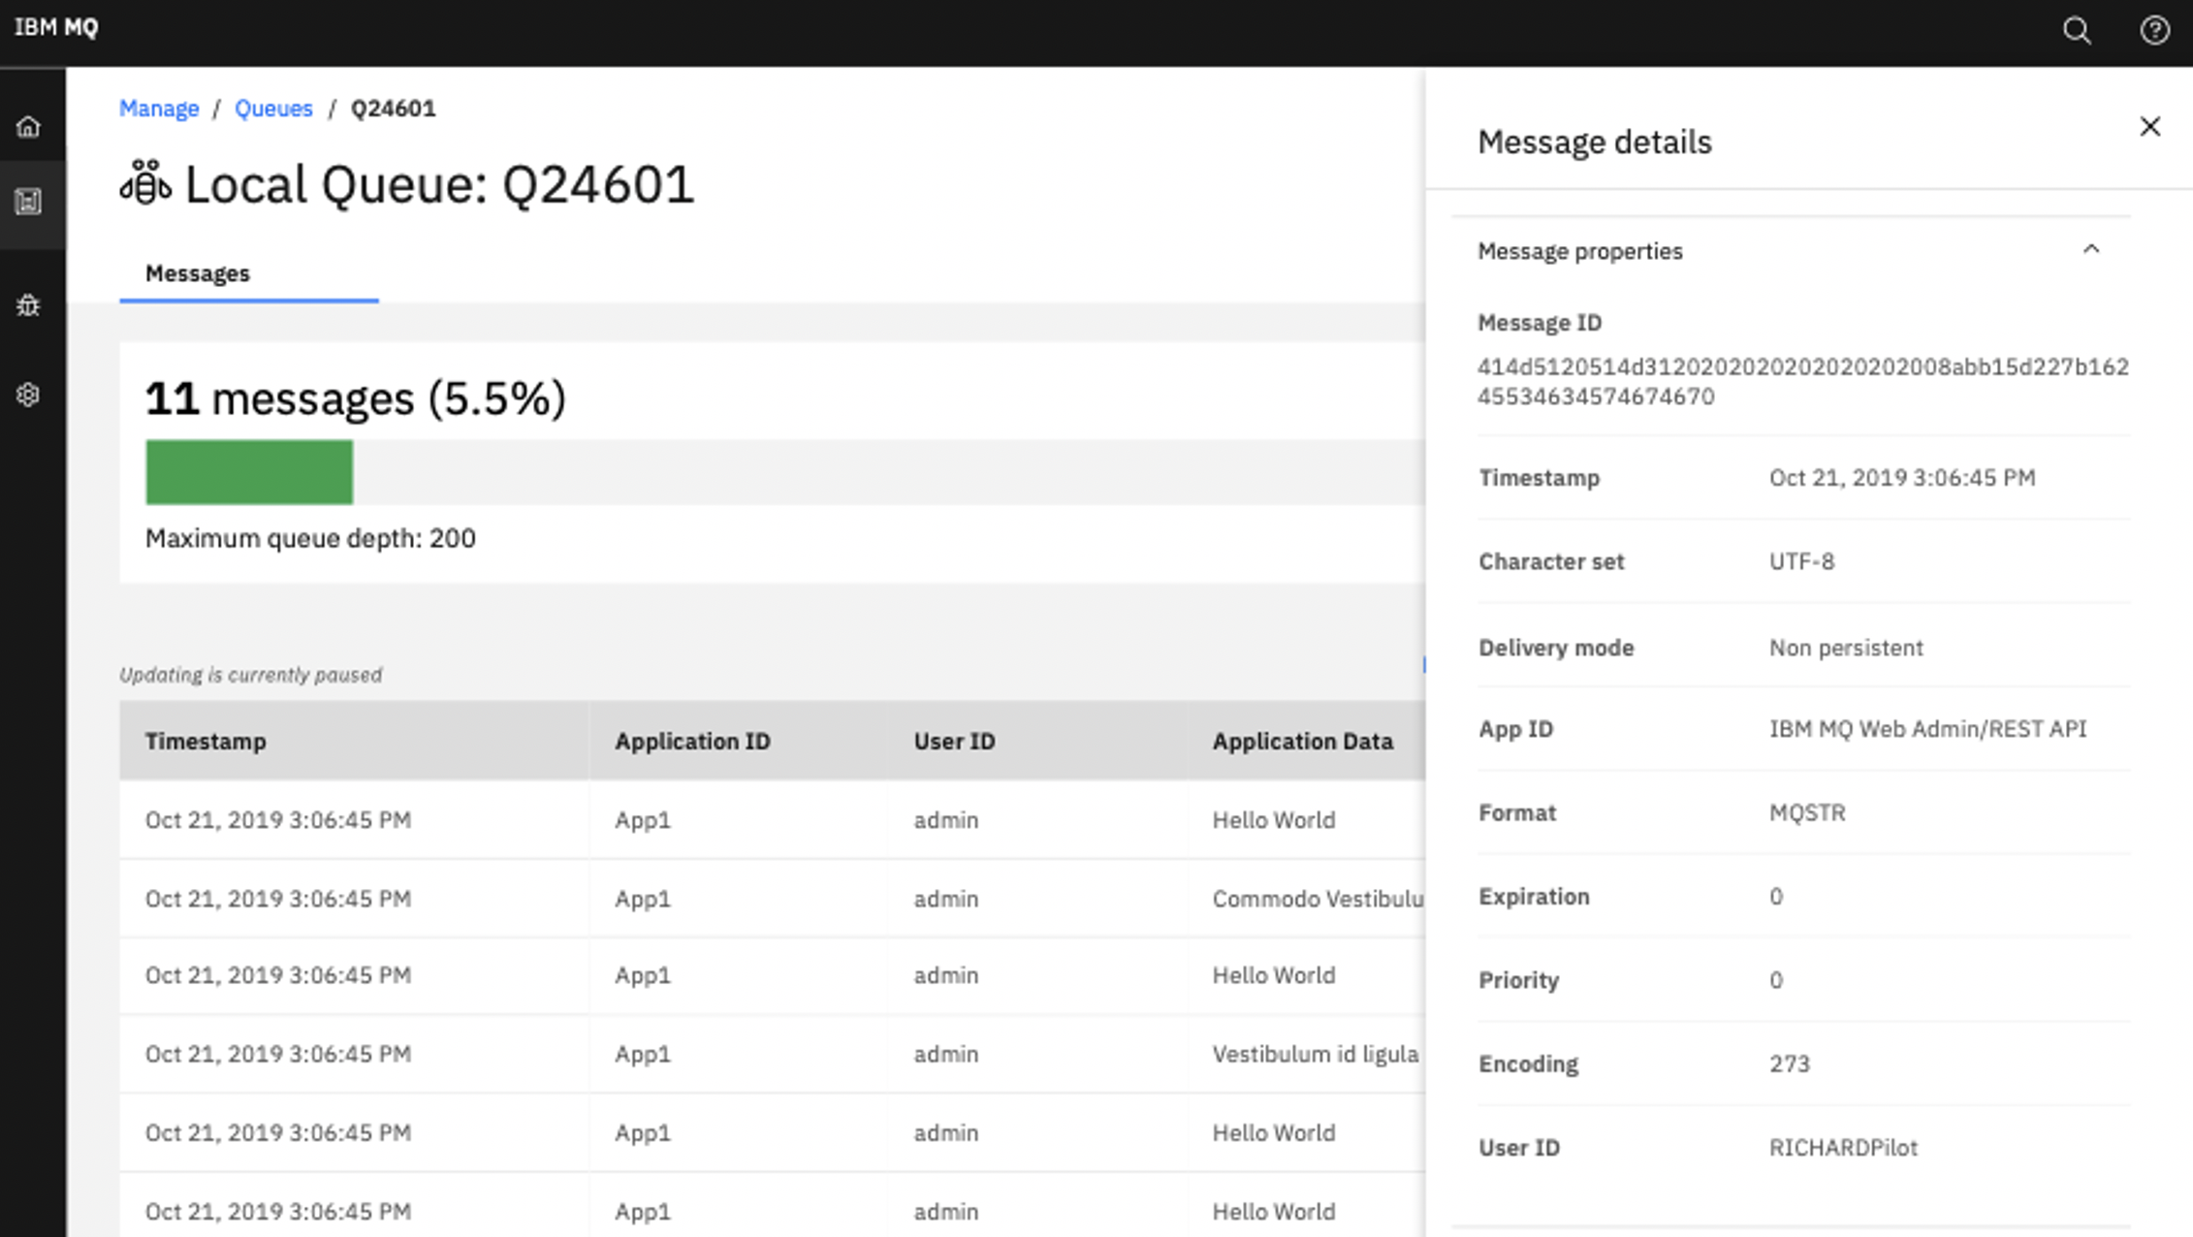
New Web Console
IBM MQ 9.1.5 CD
MQ 9.1.5 CD replaces the existing web console with a new web console on the Distributed platforms
Focus is on user experience and consistency across IBM products
https://community.ibm.com/community/user/imwuc/blogs/callum-jackson1/ 2020/04/09/enhanced-web-console-in-ibm-mq-915

Slide 40

Managing channel CipherSpecs
IBM MQ 9.1.1, 9.1.4, 9.1.5 CD
Making it easier to keep up-to-date with ever changing ciphers, simplifying migration
MQ 9.1.4 CD adds TLS 1.3 support for Distributed queue manager channels and C-based clients. 9.1.5 has added support for Java 11 applications which is needed for TLS 1.3 support there.
Rather than needing to match the CipherSpec on both ends of a channel, MQ has introduced ANY_TLSxx and ANY_TLSxx_OR_HIGHER CipherSpecs and MQ will negotiate the CipherSpec available to both ends
For 9.1.1, the distributed platforms also added the ability to configure exactly which CipherSpecs a queue manager will accept
CipherSpec A
CipherSpec A
SSL
TLS 1.0
CipherSpec ANY
CipherSpec ANY
TLS 1.2
TLS 1.3
MQ 9.2 has a reordering of the CipherSpecs to match common views on levels of security and the ability for you to reorder that list

Slide 41
Passwords and Credentials
Where passwords or other credentials need to be stored in a configuration file, many can now be protected with a user-supplied key in a consistent fashion
Components include
- MQ IPT
- AMS Java applications
- Salesforce Bridge
- Blockchain Bridge
- MFT
The new feature consists of 2 parts:
- A stronger algorithm
- Ability to use a custom encryption key
[route]
Name=TLS server sample
Active=false
ListenerPort=1416
Destination=mqserver.company1.com
DestinationPort=1415
SSLServer=true
SSLServerCipherSuites=SSL_RSA_WITH_AES_256_CBC_SHA256
SSLServerKeyRing=/opt/mqipt/samples/ssl/sslSample.pfx
SSLServerKeyRingPW= <mqiptPW>1!y35nwg8ar0TQKzpmS3U+Yw==!j5CFZorXayYziS4EjbATbg==
SSLServerDN_O=IBM*
SSLServerDN_CN=*Example Certificate

Slide 42




Advanced Message Security
End-to-end application-to-application encryption may give you the highest level of security, but it’s not always possible to use. For example, where the applications are not AMS enabled or where the originators or recipients of the messages are outside of your domain
encrypted
App
App
Application to application

Slide 43
Advanced Message Security
End-to-end application-to-application encryption may give you the highest level of security, but it’s not always possible to use. For example, where the applications are not AMS enabled or where the originators or recipients of the messages are outside of your domain
MQ on Distributed long-ago implemented client level interception to apply AMS policies once messages reach or leave their first queue manager
encrypted
App
App
Queue manager entry

Slide 44
Advanced Message Security
IBM MQ Advanced 9.1.3 CD z/OS
End-to-end application-to-application encryption may give you the highest level of security, but it’s not always possible to use. For example, where the applications are not AMS enabled or where the originators or recipients of the messages are outside of your domain
MQ on Distributed long-ago implemented client level interception to apply AMS policies once messages reach or leave their first queue manager
MQ 9.1.3 on z/OS adds the ability to apply those policies at a queue manager-to-queue manager boundary. This enables the use of AMS within one domain without affecting another
encrypted
App
App
Organizational boundary

Slide 45




Dataset encryption with MQ on z/OS
z/OS added support for policy based dataset encryption in z/OS 2.2 and later, utilising a CryptoExpress coprocessor
With MQ 9.1.5 CD, Dataset encryption can be used with all of MQ’s datasets
This provides encryption at rest for MQ data, although MQ’s Advanced Message Security capability goes further by providing true end-to-end encryption
Pervasive encryption with IBM z Systems
Integrated Crypto Hardware
Data at Rest
Network
Clustering
Data in Use
101
https://community.ibm.com/community/user/imwuc/viewdocument/mq-and-the-use-of-data-set-encrypti?CommunityKey=b382f2ab-42f1-4932-aa8b-8786ca722d55

Slide 46
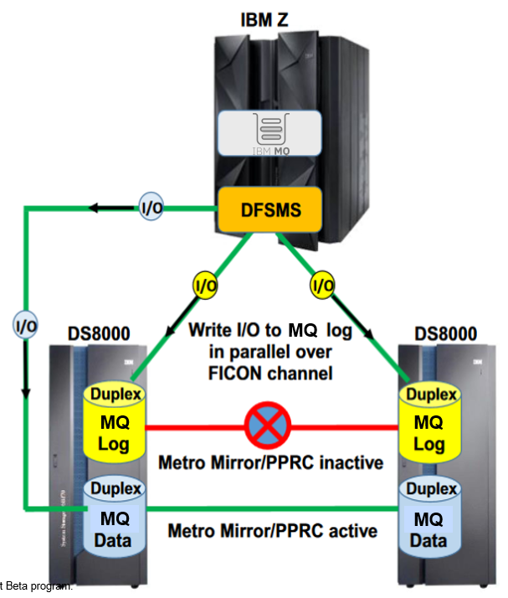
z/OS zHyperwrite
IBM MQ 9.1.2 CD
Reduces the cost of using PPRC (Metro-Mirror) to synchronously replicate log data by issuing the write to the primary and secondary copies of the data at the DFSMS (Media Manager) level.
This allows the writes to occur in parallel instead of in series.
Reduced I/O times by up to 60%.
Reduced elapsed time for commit by up to 60%, which can reduce contention.
Improved the sustained log rate, allowing each queue manager to process up to 2.4 times the volume of workload.

Slide 47

Managed File Transfer
IBM MQ Advanced 9.1 LTS + All platforms
MFT manages your file transfers, with file-to-file and file-to-message.
MQ 9.1.x continued to focus on resiliency and ease of administration.
Active/standby MFT agent support adds highly available topologies
Expanded the breadth of REST APIs, both for monitoring and configuring MFT resources and for initiating file transfers.

Slide 48
Building applications

Slide 49
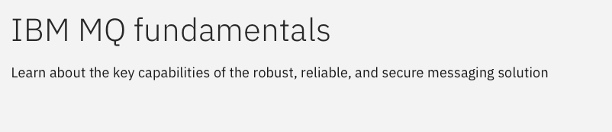
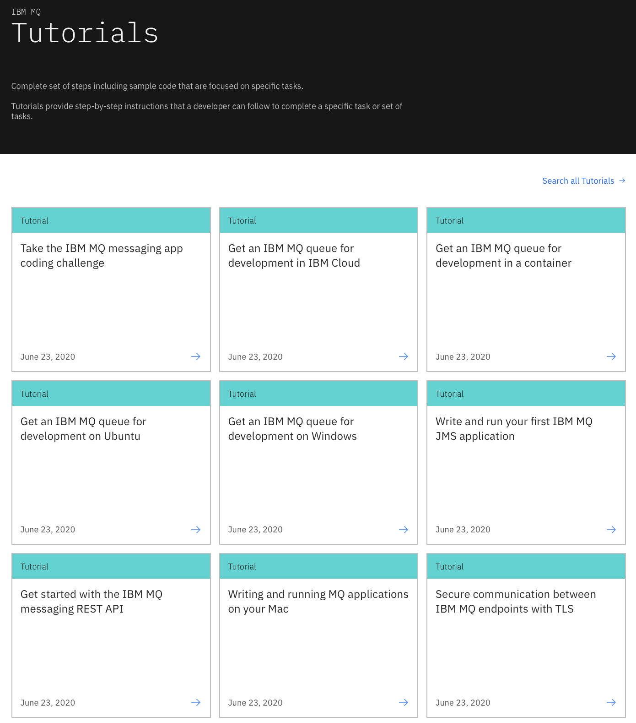
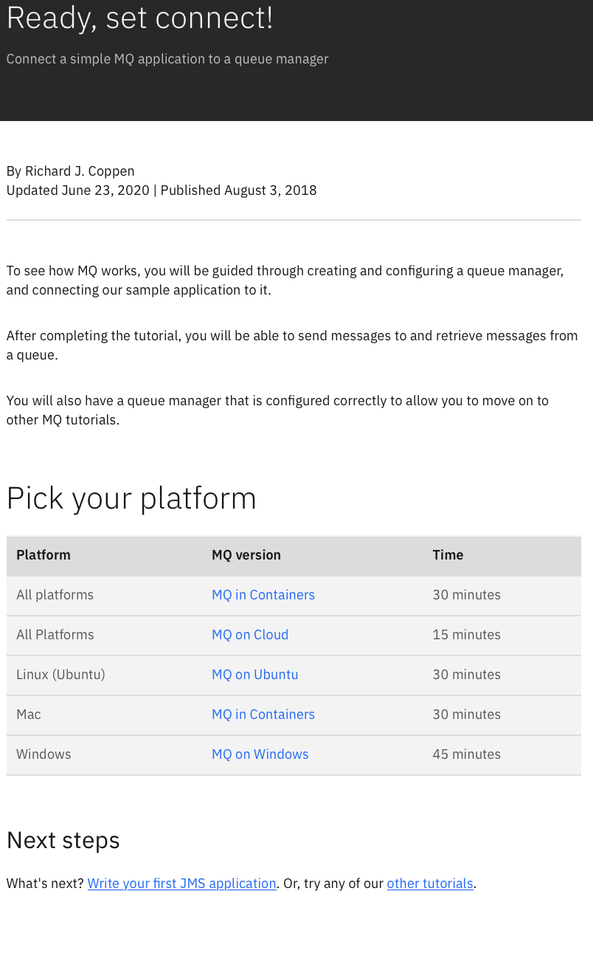
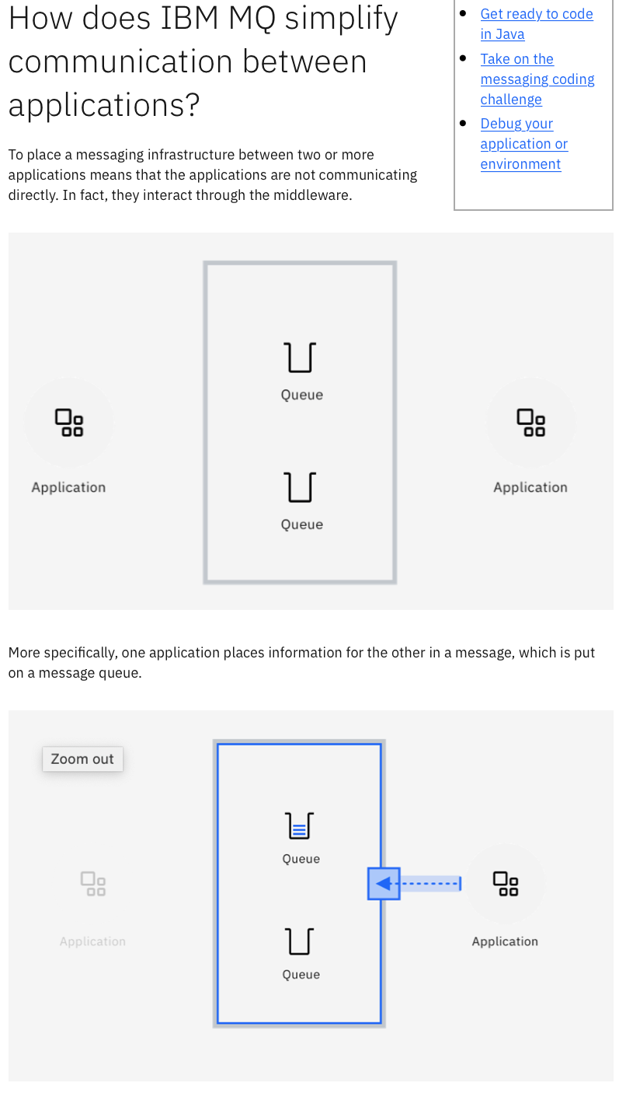
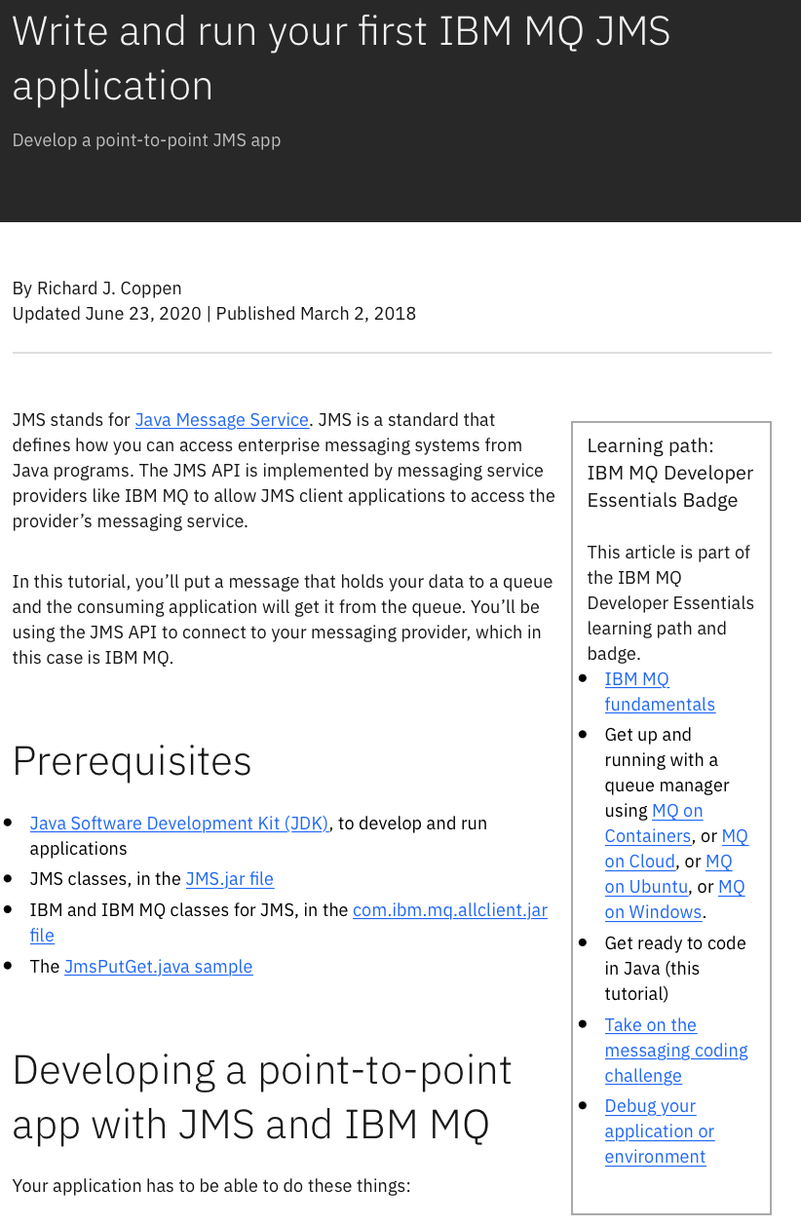
learn-mq
Finding it hard to get developers started with MQ?
Point them to:
ibm.biz/learn-mq
Totally new to MQ? Learn the basics
Step-by-step guide to getting up and running with MQ
Tutorials on building your applications

Slide 50
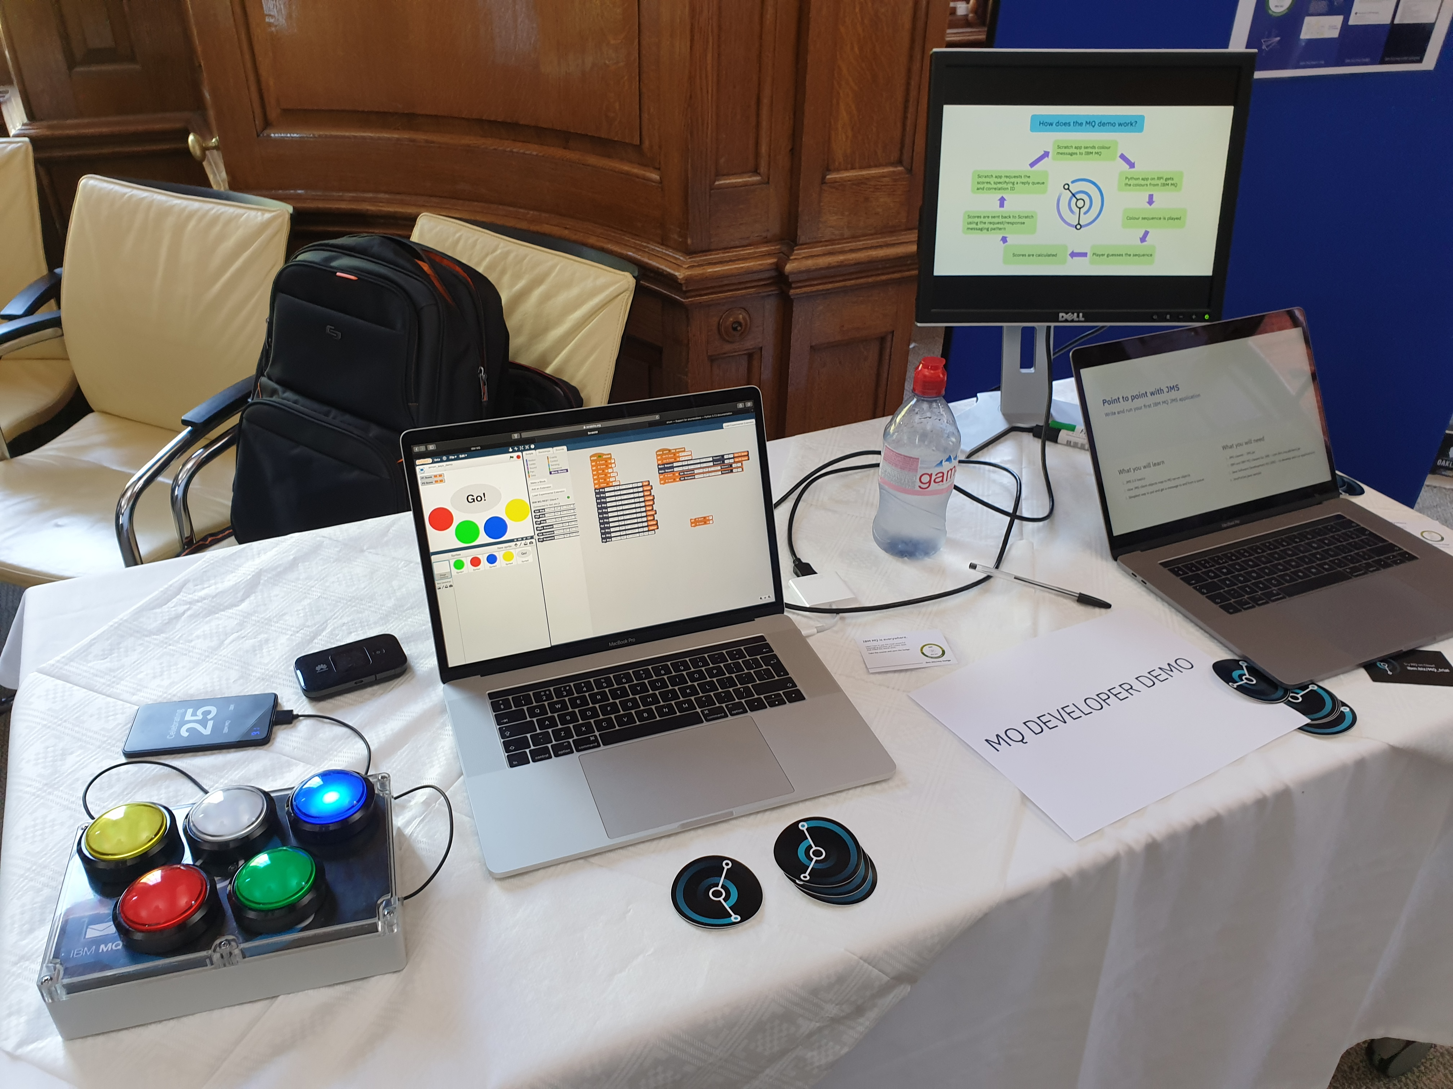
Demonstrating the simplicity of MQ
There’s nothing like flashing lights and wires to grab people’s attention. We want everyone to know how easy it is to write messaging applications and how powerful MQ is in supporting them
Ever tried Scratch, a graphical way to code, aimed at kids but ideal to show how easily asynchronous messaging can improve your applications with an MQ plugin
Heard of the Raspberry PI? You think MQ is a heavyweight solution? We run an HA pair of queue managers on two $5 Raspberry PI Zeros!
The PI version of MQ is now available under a developer (unsupported) license
ibm.biz/ibmmq-scratch
ibm.biz/ibmmq-pi

Slide 51


Developing applications
Build your applications simply, with no need for an MQ installation
Pull Java directly from the Maven repository and .NET from NuGet
The SDK has been added to the MQ redistributable client, removing the need to install it to build from
Develop your applications on the platform of your choice for free
The full MQ Advanced for Developers is available on Windows and Linux with the addition of a MacOS MQ client and SDK for Developers
IBM
npm
Maven
NuGet
ibm.biz/MQdownloads
</>
Notes:
No-longer is it a case of needing to install MQ in order to be able to build a application
The redistributable MQ client now provides all you need
MQ client libraries and Jars are now available where you need them
Anonymous download Maven NuGet (soon!)
And to make it easier to write your applications, it’ll soon be easier to do so on a Mac with a developer edition client.

Slide 52
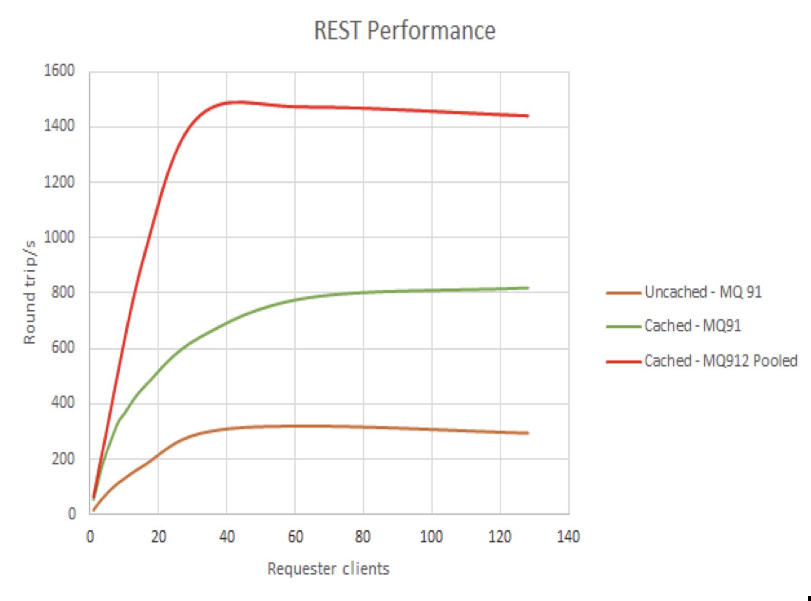

Writing new applications
REST Messaging
Providing a very simple way to get messages in and out of your MQ system
9.1.2 CD boosted the performance capability, 9.1.3 CD added message browse and 9.1.5 CD added publish
.NET Core
9.1.1 CD brought support for .NET Core on Windows
9.1.2 CD added Linux support
Open Source language bindings
Write MQI applications in Node.js and Golang
New simpler JMS style API for Golang
github.com/ibm-messaging
put, get, browse, publish
REST
Windows
.NET Core
Linux
Node.js MQI
Golang MQI
Golang JMS
github.com/ibm-messaging
Notes:
Application environments and languages are rapidly evolving
MQ 9.1.1 and 9.1.2 add support for MQ with .NET Core
MQ provides open source MQI language bindings for NodeJS and Golang. With a new JMS-based API just available for Golang.
REST messaging is the universal backstop, to allow simple message ingress/egress over HTTP.
REST messaging is continuing to evolve. With better performance in 9.1.2 and greater function in the future, such as message browse.

Slide 53

Run IBM MQ in any location or cloud, exactly as you need it
AWS
Azure
IBM Z
Linux
AIX
Windows
AWS
IBMi
HPE NonStop
zLinux
IBM Cloud Private
Appliance
Kubernetes
IBM Event Streams
IBM Event Streams

Slide 54
Thank you

